Slide 1

AIPI
Accelerating the Value of Science & Deep Tech
143 Hills Road, Cambridge, CB2 8RA, UK
8230 Leesburg Pike, Vienna, VA, 22182, USA
March 2026
INNOVATE AND THRIVE

Slide 2
The Problem: Too Much IP Is Undervalued & Underexploited
Owning a patent doesn’t guarantee receiving value from it. Most IP owners face three critical gaps (the IP dilemma):
No IP Landscape Visibility
No IP Commercialisation Map
No IP Strategy
Despite the world-leading innovation created in the science & technology communities, too much of it remains poorly understood and inconsistently exploited.
Most creators and owners don’t know how their IP relate to other granted and pending patents. They cannot identify where they are exposed, where gaps exist, or how defensible their IP is.
Hence investment decisions and licensing negotiations are made in the dark.
Even where IP is strong, owners rarely have a systematic view of which applications it can enable and what revenue potential those have.
Nor what competing solutions exist, or how much value potential applications could create against that compettion.
Hence missed licensing or business creation opportunities and stalled commercialisation.
Without a understanding of the IP landscape and viable commercial routes, IP creators and owners cannot make confident decisions about portfolio development, licensing strategy or R&D and IP investment priorities.
Hence the real risk that valuable IP sits idle while investment is made in IP that is uncompetitive or is focused on the wrong applications.
AiPi LLC | www.AiPiSolutions.com | Confidential

Slide 3
What AiPi Delivers: Two Distinct Solutions to the IP dilemma
AiPi’s proprietary AI platform produces two structured outputs that transform raw IP into actionable intelligence.
SOLUTION ONE
SOLUTION TWO
Patent Landscaping
Commercialisation Landscaping
A structured map of how a client’s granted or pending IP sits within the existing patent landscape — showing where it overlaps with competitor filings, where adjacent gaps exist, and what IP territory remains available.
The client gains:
Clear view of IP defensibility
Identification of gap opportunities for portfolio expansion
Evidence base for investment and licensing negotiations
A commercial analysis that identifies potential applications of the IP, mapping these against existing competing solutions, and estimating the value that could be created by exploiting each potential application and its best route to market.
The client gains:
Prioritised list of commercial applications
Comparative assessment against alternative solutions
Quantified value potential for each route to market
AiPi LLC | www.AiPiSolutions.com | Confidential

Slide 4
SOLUTION ONE
Competitor Filing Analysis
AiPI maps every relevant patent filing in the target domain, showing exactly how the client’s IP overlaps with or is differentiated from competitors’ IP— giving a precise picture of the legal position.
Patent Landscaping
Mapping how IP fits into the pending and granted patent landscape, including adjacent patents and gaps in the landscape.
Adjacent Gap Identification
AiPi identifies patent gaps adjacent to the client’s and competitors’ existing IP — white spaces where new filings could extend the IP portfolio, strengthening its defensive position, or opening entirely new licensing opportunities.
Deliverable: A Clear, Actionable Landscape Document
The output is a structured report the IP owner, investors, and legal advisers can act on directly — not a data dump. It supports investment decisions, licensing negotiations, and portfolio strategy.
AiPi LLC | www.AiPiSolutions.com | Confidential

Slide 5
SOLUTION TWO
Application Identification
AiPI systematically identifies the full range of potential applications for the client’s IP across sectors and use cases — including applications not previously considered — and ranks them by commercial feasibility.
Commercialisation Landscaping
Mapping commercial applications, competing solutions, and the value each application could generate.
Competitive Solution Mapping
For each application, AiPi maps existing competing solutions — products, services, and technologies — and assesses where the client’s IP offers a genuine advantage in terms of performance, cost, or defensibility.
Value Quantification by Route to Market
AiPi estimates the commercial value each application could generate, enabling clients to prioritise routes, structure licensing terms, and make defensible business cases to investors or partners.
AiPi LLC | www.AiPiSolutions.com | Confidential

Slide 6
How AiPi Works: From Unsorted IP to Actionable Intelligence
A streamlined four-stage process, powered by proprietary AI, typically completed within four to six weeks of engagement.
1
2
3
4
IP Intake
AI Platform Analysis
Expert Synthesis
Delivery & Briefing
A client shares registered IP. AiPi reviews patent filings, technical specifications, and any existing commercialisation context.
Our proprietary platforms ingest and analyse global patent databases and commercial market data, mapping the client’s IP against the full competitive landscape.
Our technical and commercial team interpret the platform outputs, validate findings, and frame conclusions in the context of the client’s objectives.
The client receive a structured landscape document plus a briefing session to walk through findings and explore next steps together.
AiPi LLC | www.AiPiSolutions.com | Confidential

Slide 7
Why AiPi: The Capability That Makes the Difference
Two things set AiPi apart from patent attorneys, management consultants, and generic research firms.
Proprietary AI Platform
Combining Technical & Commercial Expertise
AiPi’s platform is built in-house by a team with deep expertise in AI, IP law and innovation financing.
The result is an analysis that is faster, broader in scope, and more precise than anything achievable through manual research — giving clients a level of landscape clarity and commercial targeting options that is unparalleled.
Most IP advisers are either patent attorneys — strong on the legal landscape but weak on commercial value — or business consultants who lack the technical depth to assess IP position accurately.
AiPi’s team integrates both: patent expertise, scientific and technical depth, and business development experience with US market knowledge — in a single, coordinated engagement – and outstanding expertise in the fine-grain application of AI.
AiPi LLC | www.AiPiSolutions.com | Confidential

Slide 8
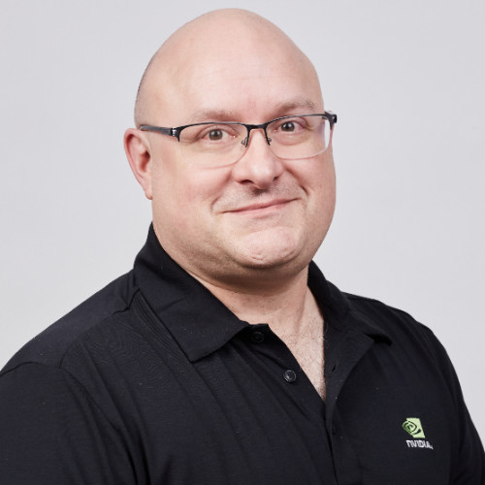

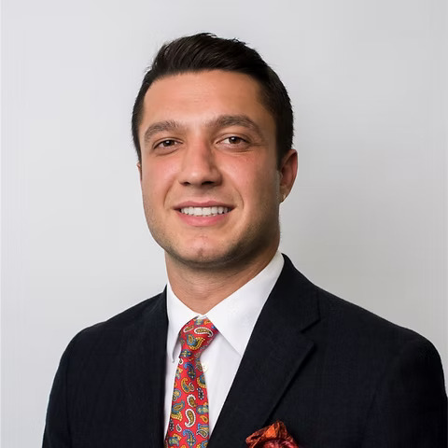
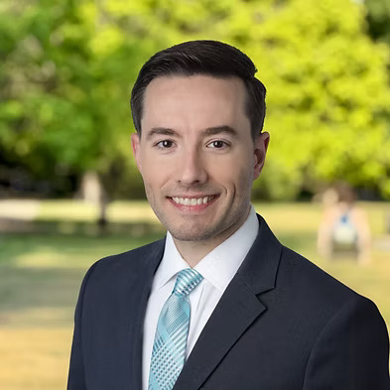
AiPi’s Leadership Team
Joe Eaton
Eric Morehouse
One of America’s leading AI scientists & managers with 13 years service at NVIDIA culminating as Distinguished System Engineer for Data & Graph Analytics.
Veteran IP attorney and entrepreneur. Founder of AiPi - with over 30 years’ experience advising clients including DoD on commercialising cutting-edge IP.
Mete Ozmen
Drew Davis
Oxford educated COO and Chief of Staff with multi-sector organisational experience building teams to solve complex operational challenges
International business development and corporate finance executive with over 20 years’ experience of innovative product go-to-market in EMEA & the USA.
AiPi LLC | www.AiPiSolutions.com | Confidential

